Slide 1
The Future of the Windows Desktop
Using .Net Core 3 Features to Improve Support for Legacy Apps

Slide 2
Paul Michaels
Plug for the book
My Blog:
https://www.pmichaels.net/
This talk:
https://github.com/pcmichaels/WindowsDesktopTalk
pmichaels.net
@paul_michaels
Notes:
Talk about how I started
Spectrum ‘83/84 48K Spectrum ZX.
Display of hands: Anyone owned a spectrum? Anyone programmed on a spectrum? Anyone heard of functions in Spectrum Basic?
1997 – professional programmer - Pascal

Slide 3
Why?
Haven’t we all agreed on the web?
Notes:
This talk is about running desktop applications on .Net Core 3. Why would we want to do that?
Next slide - legacy

Slide 4
Legacy
- WinForms
- WPF
- UWP?
Notes:
You may have legacy apps running on earlier versions of the framework

Slide 5
Still a place for desktop?
NO client server traffic for updating a screen
Scaleable (you should only make calls when you need to read from or write to the server)
Total control over your environment
Arguably faster to write (certainly WinForms)
No need for an internet connection
Notes:
Selling the desktop

Slide 6
WinForms – Is it all that bad?
It really is
But…
.Net Framework
Try employing people to work on it!
Platform Specific
Typically not very testable, and not very tested
Hard to deploy
Fast to develop
Your apps may already be written and running
Users are used to it – everyone likes battleship grey!

Slide 7

Demo – Migrate WinForms to .Net Core
Notes:
Show GenerateLargeFiles
Helpers
Portability analyser
Steps to upgrade:
Create a new project in the same solution
Add existing files (see the compile include – compile include wildcard – can’t do a full wildcard, because it includes all the .Net Framework directories - properties, etc..)
Add NuGet packages
Speed! Around ¼ to 1/3 faster
Following slides are what we did in the demo

Slide 8
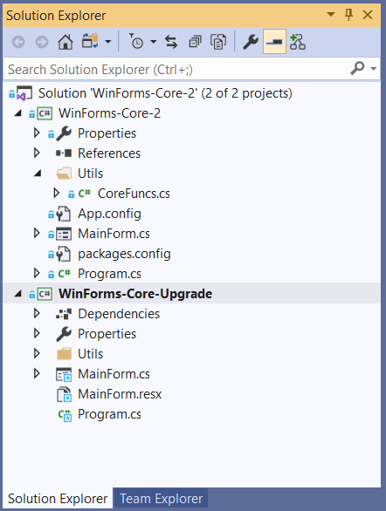
Create new Project
Notes:
You can upgrade in-situ – your choice

Slide 9
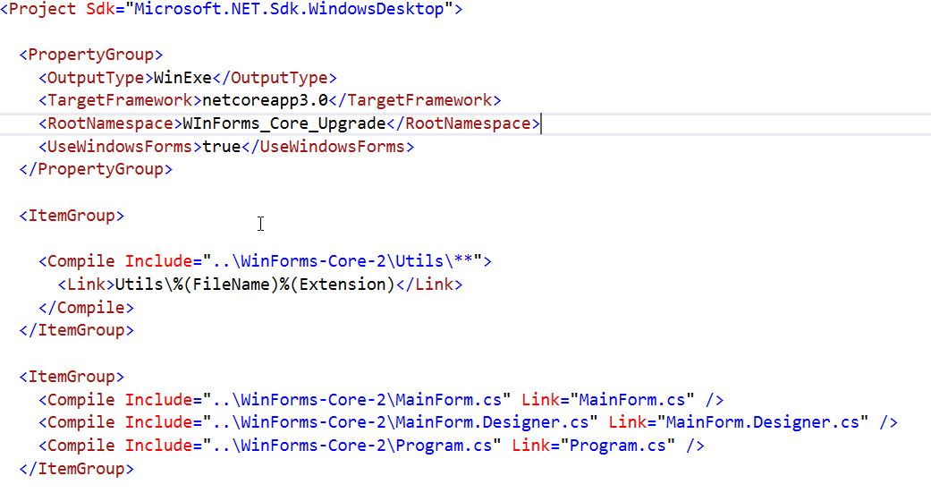
Add Existing Files
Notes:
You can also copy and paste

Slide 10
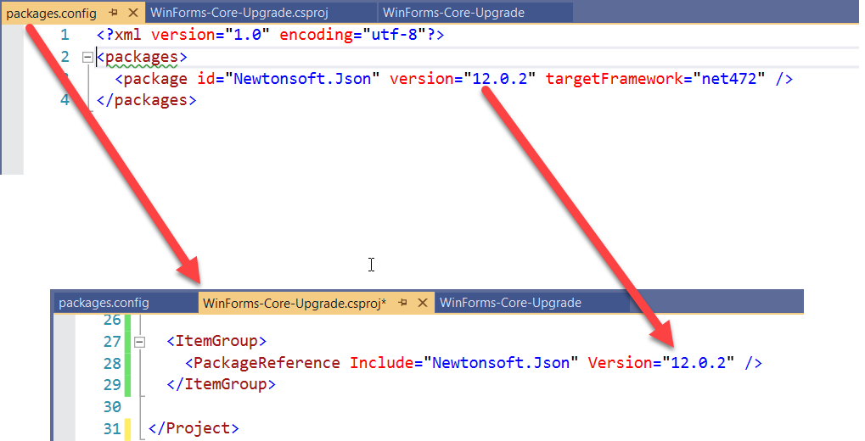
NuGet
Notes:
Packages.config -> csproj file

Slide 11
WinForms – Still all that bad?
.Net Framework
Try employing people to work on it!
Platform Specific
Typically not very testable, and not very tested
Hard to deploy
.Net Core 3
Still platform specific, but that’s probably what you want
If your app isn’t properly tested, this won’t help you!
Single exe and tree shaking!

Slide 12

Demo – Single Exe and Tree Shaking
Notes:
Publish the app as is
Runtime identifier (includes the runtime by default)
SelfContained = false (back to default)
PublishSingleFile (note file size)
PubishTrimmed (note file size)

Slide 13
Tree Shaking, Compilation and Single Exe
PublishSingleFile (output as a single exe)
RuntimeIdentifier (target platform)
PublishReadyToRun (compiled – sort of – just faster)
PublishTrimmed (tree shaking)
SelfContained (include the runtime – defaults to true where the runtime identifier is set)

Slide 14
WPF – The Kiosk Application
WPF is cool isn’t it?
It was
Xaml (XML is the language that Json could have been!)
Similar to UWP and Xamarin Xaml
Xaml standards are supposed to be aligning… soon
Binding (features)
Testability (Compared to WinForms!)
MVVM
Can be (sort of) cross platform
INotifyPropertyChanged
Binding (complexity)
Resources
Deployment (ClickOnce)
Notes:
Every WPF App seems to be a kiosk application

Slide 15

Demo – WPF to .Net Core 3

Slide 16
WPF – Still tech from 2006?

Slide 17
Demo - MSix

Slide 18
Xaml Islands
Create Controls in UWP that can be used in WinForms or WPF

Slide 19

Demo - Xaml Islands

